Slide 1
Information About Rank Order Lists and NRMP Policy
2013
Main Residency
MatchSM

Slide 2
Getting Started
Listen to webcast: Creating a Rank Order List - http://www.nrmp.org/rol2013.pdf
Review ROL section of User Guide
Use your AAMC ID and password to login to the NRMP’s Registration, Ranking, and ResultsSM (R3SM) system
Couples must register both partners’ AAMC IDs in their NRMP files
Your NRMP/AAMC ID and your ERAS/AAMC ID must be the same
Notes:
The Applicant User Guide is available to registered users of the R3 system when they log in with their AAMC ID number and password.
Make sure your NRMP and ERAS AAMC IDs are the same; if they do not match, contact the NRMP immediately.

Slide 3
Definitions
Match Status: ACTIVE Registered
RANKING ROL started
CERTIFIED ROL ROL finished
Fee Status: PAID No fees due
Credentials: VERIFIED By school
(US, Osteo, Canadian applicants)
EC
FMG Status: VERIFIED By ECFMG
(IMGs & 5th Pathway applicants)
Match Status: ACTIVE Registered
RANKING ROL started
CERTIFIED ROL ROL finished
Fee Status: PAID No fees due
Credentials: VERIFIED By school
(US, Osteo, Canadian applicants)
ECFMG Status: VERIFIED By ECFMG
(IMGs & 5th Pathway applicants)
Notes:
An applicant becomes ACTIVE after he/she Updates My Profile, accepts the Terms and Conditions of the Match, and pays the registration fee.
Additional fees are incurred if participating as a couple ($15/partner) or submitting a rank order list with more than 20 programs ($30/rank >20). For couples, additional fees are incurred when a partner ranks more than 30 unique programs. These fees must be paid at the time they are incurred or the next time the applicant logs into R3. Fees are not refundable.
US allopathic, osteopathic, 5th Pathway, and Canadian applicants have their graduation verified by their schools.
International medical school and 5th Pathway applicants have their credentials verified by ECFMG.

Slide 4
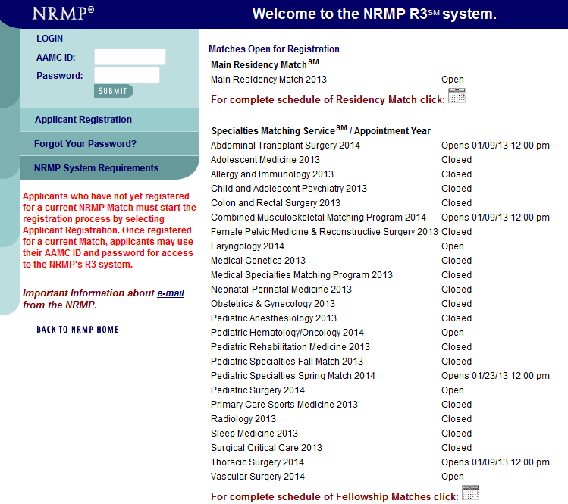
Notes:
Go to the NRMP Home Page (www.nrmp.org)
Select Register / Login and select “2013 Main Residency Match” written in red at the top of the screen
Once directed to the R3 system, use your AAMC ID and password to access the NRMP’s Registration, Ranking and Results (R3) system
If you forgot your password, contact the NRMP or click on “Forgot Your Password?” and follow the instructions. You must correctly answer your security questions to obtain a new temporary password.

Slide 5
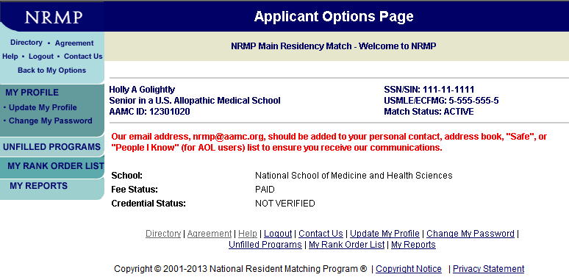
Notes:
You can modify your profile information. From the left menu bar, click on “Update My Profile” and then click “Edit”.

Slide 6
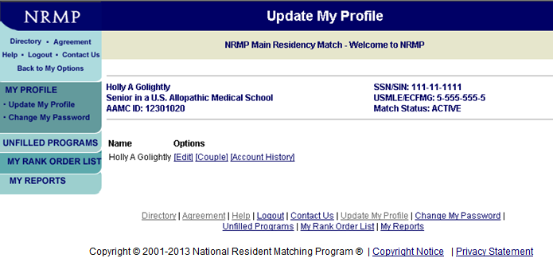
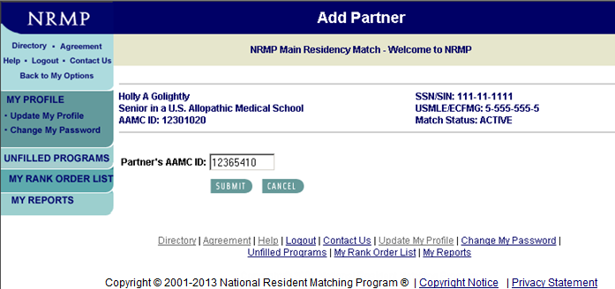
Notes:
From the Update My Profile screen you can edit your biographical information and/or register for the Match as a member of a couple.
If you are participating as a member of a couple, you must add your partner by clicking on “Couple”. Then enter your partner’s AAMC ID and click “Submit”.
Your partner’s name will appear. Click on “Submit” at the bottom of the screen to confirm your partner.
The $15 per partner couple’s fee should be paid on-line at the time you register as a couple by clicking on “Balance Due” which will appear on the Update My Profile screen after coupling.

Slide 7
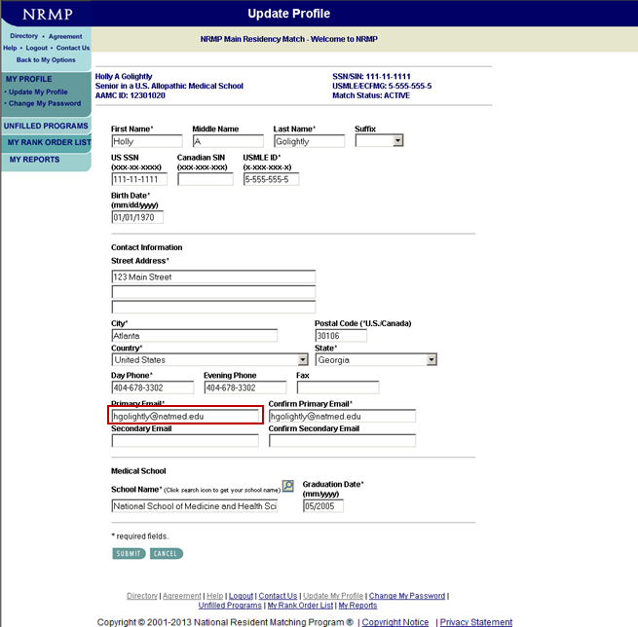
Notes:
E-mail is the primary means of communication from NRMP. Keep your e-mail address current!
NRMP sends bulk e-mail messages to applicants which some internet providers (i.e. Gmail, Hotmail, Yahoo and AOL) may classify as junk mail. Turn off any junk mail filters and/or add support@nrmp.org to your address book or list of “trusted” or “safe” addresses so you will not miss receiving messages from NRMP.

Slide 8
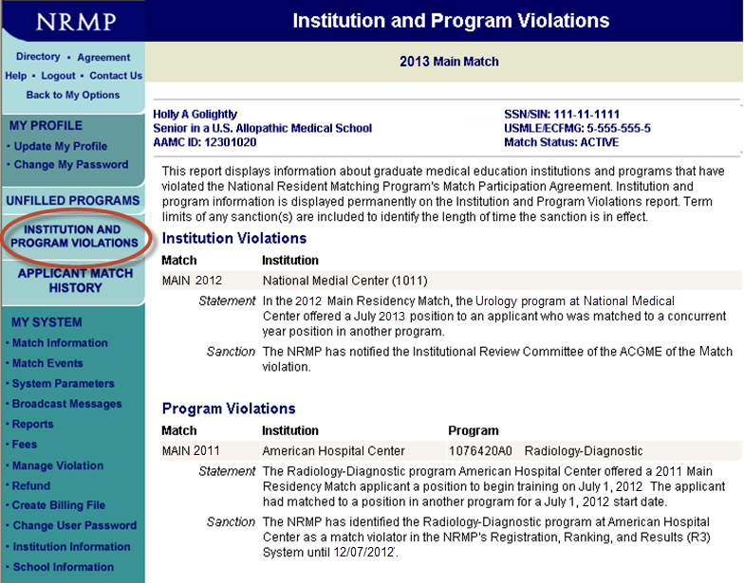
Notes:
To view the list of programs found in violation of the Match Participation Agreement, select Institution and Program Violations from the left menu bar. You may wish to consult this report when considering the programs with which you want to interview and/or rank.
The Institution and Program Violations report provides information about confirmed violations of Match-participating programs and institutions to applicants and NRMP school officials. A brief statement of the nature of the NRMP’s investigation is included, along with a brief description of the sanction levied (if any). Applicants can access this Report at any time to confirm whether a program or institution in which they are interested in applying has had any prior entanglements with the NRMP.

Slide 9
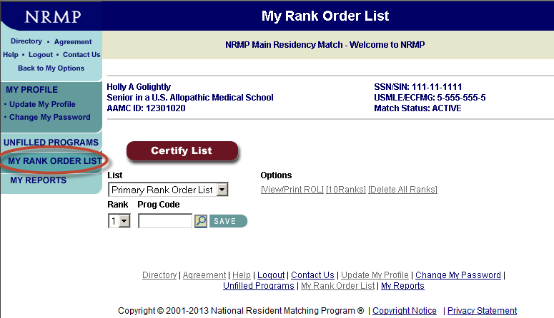
Notes:
To create your rank order list, click on “My Rank Order List” from the left menu bar.
You can enter one rank at a time by entering the program code in the “Prog Code” box, or up to 10 ranks at a time if you select “10 Ranks.”
You can add programs at different times.
You can mix advanced, categorical, and preliminary programs, as well as specialties and geographic locations, on your primary rank order list.
To search for the NRMP code of a program you wish to rank, click on “Directory” in the upper left corner of the screen or on the magnifying glass icon next to the “SAVE” button.
For Help, click on “Help” in the upper left corner of the screen. You can then search the contents of the User Guide.

Slide 10
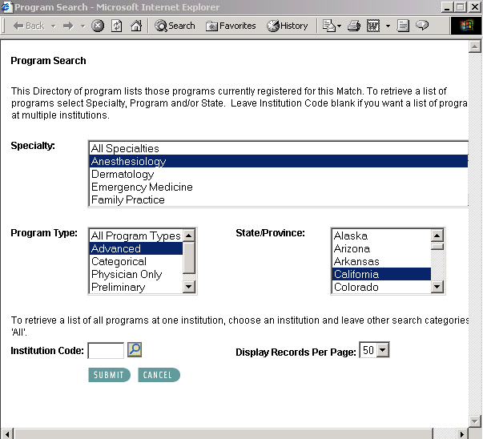
Notes:
In the directory you must select a specialty, program type, and location.
The search shown is for advanced (PGY-2) Anesthesiology programs in California.
Leave the institution code blank and click the “Submit” button.

Slide 11
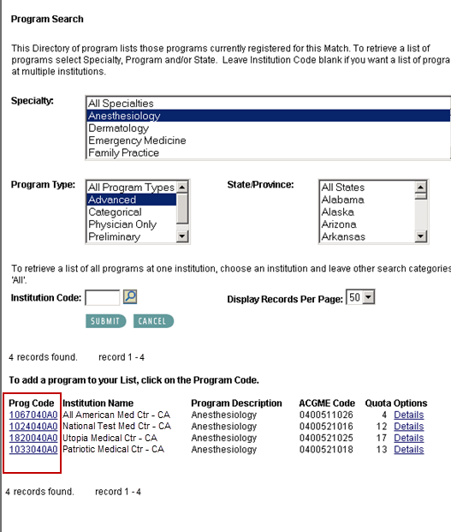
Notes:
Displayed are all of the PGY-2 Anesthesiology programs located in California currently participating in the Match; program codes are shown on the left.

Slide 12

Notes:
Enter the code of the program in the Prog Code box and click on “SAVE”.

Slide 13
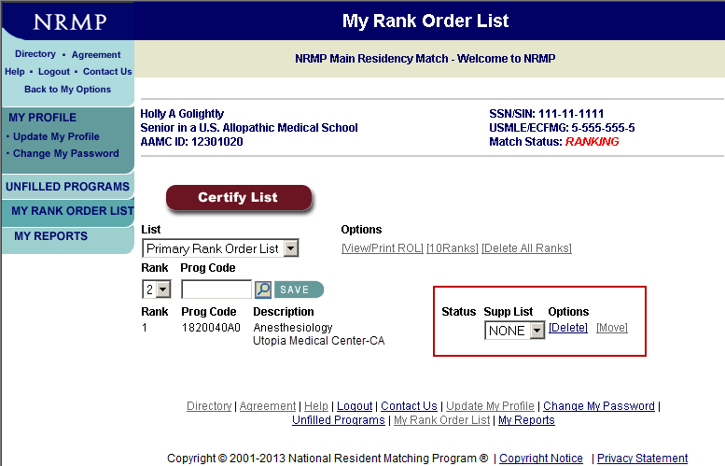
Notes:
When an advanced program is entered on the primary rank order list, a box appears under “Supp List.”
The applicant may create a supplemental list of preliminary or transitional programs for the PGY-1 year of training.
Supplemental rank order lists are used in the Match only if the applicant is matched to an advanced program linked to that supplemental list. Supplemental rank order lists are NOT linked for applicants participating in the Match as a couple!
For your first supplemental list, select “New” from the dropdown list under “Supp List” and a new screen will appear automatically.

Slide 14
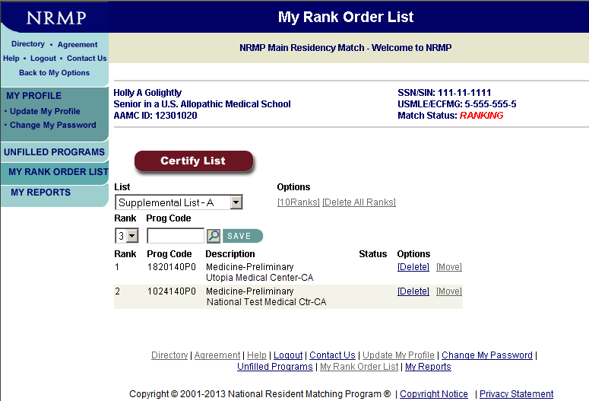
Notes:
Then enter the codes for PGY-1 programs for this supplemental list.
The first supplemental list created will be List A, the second List B, etc.

Slide 15
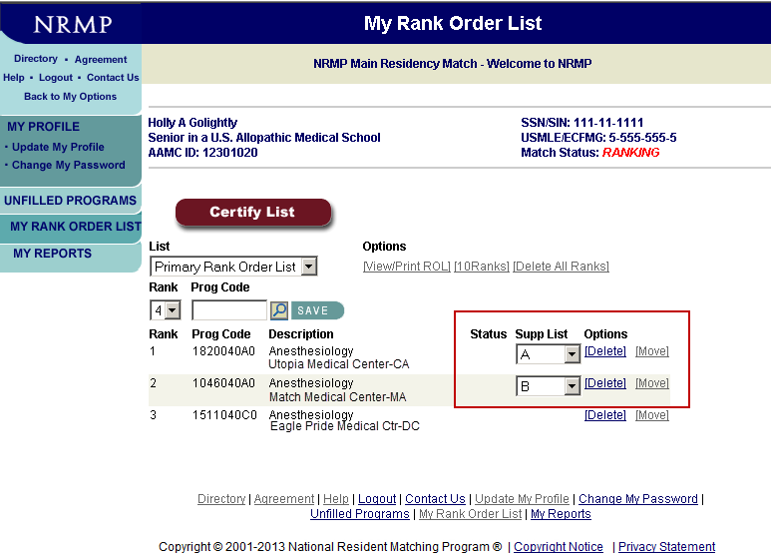
Notes:
Attach a supplemental list to each advanced program on your primary rank order list or select “NONE” if one is not needed.
This applicant is using different lists (A and B) for his two advanced programs. List A would have PGY-1 programs in the Stanford area of California while List B would have programs in the Sacramento area of California. However, the same supplemental list could be used for all advanced programs ranked.
You can delete programs by clicking on the “Delete” link under Options.

Slide 16
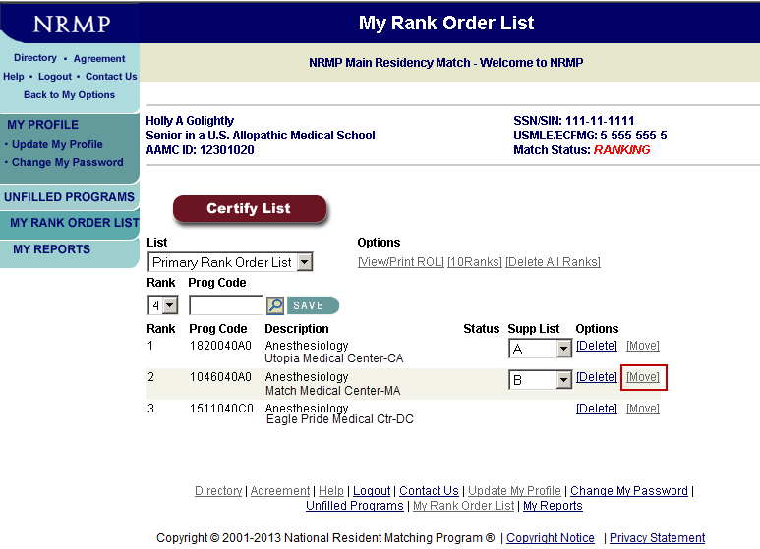
Notes:
You can change the order of programs on your rank order list by clicking the “Move” link under Options.

Slide 17
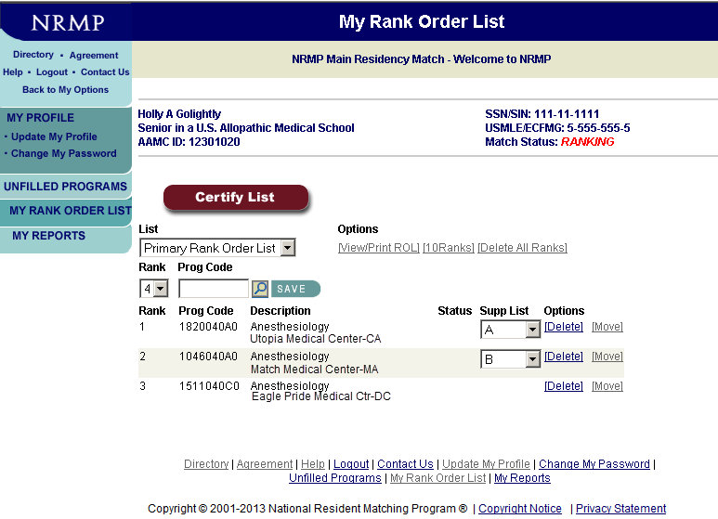
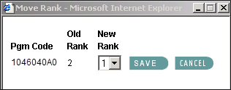
Notes:
Enter the new rank number for the program being moved (UC Davis) and click on “SAVE”.

Slide 18
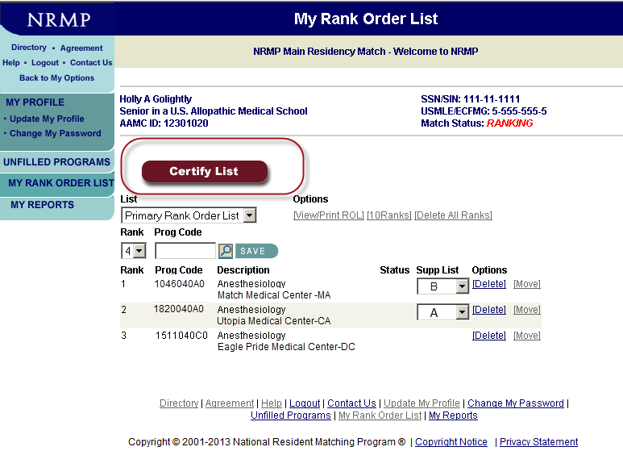
Notes:
The UC Davis program now is ranked number 1.
When you have completed your rank order list entry, you MUST CERTIFY IT – that tells the NRMP that your ROL is ready to be used in the Match.
Click on “Certify List”.

Slide 19
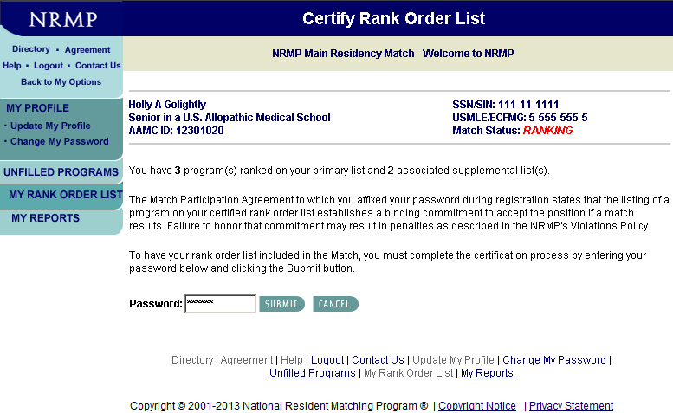
Notes:
To certify your ROL, enter your password and click on “Submit”.
Remember, when you certify your rank order list you enter into a binding commitment to accept a position should a Match occur and to begin training in good faith on the date specified in the appointment contract. Failure to honor the commitment is a violation of the Match Participation Agreement you signed when you registered for the Match. Information on NRMP policy is discussed later in this presentation.

Slide 20
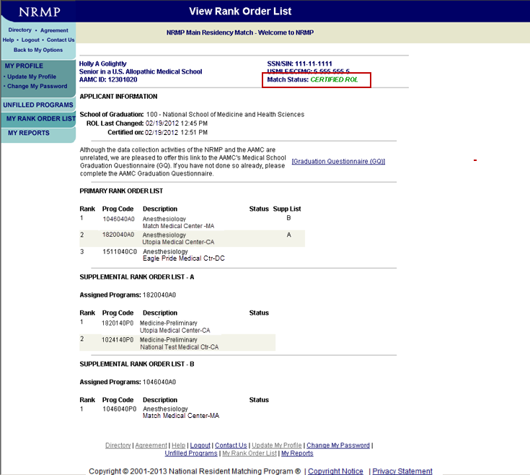
Notes:
Your complete rank order list will be displayed on the View Rank Order List page. Note that your Match Status has changed from “Ranking” to “Certified ROL” which is displayed in green at the top of the page.
NRMP recommends that you print a copy of your list using the print function on your browser or the View/Print ROL link on the My Rank Order List page.
You can make changes to your list after it is certified, up until the rank order list deadline, but you must re-certify it after each change.
Please note that the System does NOT save any version(s) of previously certified rank order lists. It saves only the version you see on the My Rank Order List page.
When ANY change is made, your list returns to ranking status and there is NO record of that earlier certified list. You MUST re-certify your list before the deadline for it to be used in the Match.
The ranking deadline is 9:00 p.m. eastern time on Wednesday, February 20. Your list must be certified at that time.
Remember: The NRMP will not add, delete, or move programs or in any way modify a rank order list after the deadline has passed.

Slide 21
Couples Information
Any two applicants can couple. A $15 per partner couples fee must be paid.
30 unique programs can be ranked by each partner before extra rank fees apply.
Each partner enters his/her own list. Lists MUST have equal number of ranks.
Applicants participating as a couple can rank the same program more than once.
Applicants decide what constitutes an acceptable pair of programs. NRMP does not check this information.
Use special code (999999999) to indicate when one partner is willing to go unmatched if the other partner matches. Code should be used at bottom of lists when other acceptable program pairs have been exhausted.
Couples are matched on PRIMARY list only – supplemental rank order lists are NOT linked.
Notes:
Couples in the Algorithm:
Lists considered together as a unit
BOTH partners must match at same rank or algorithm continues
Couples can “half-match” when code 99999999 (‘No Match’) code is used

Slide 22
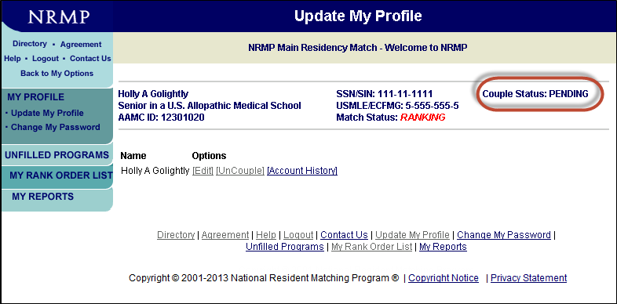
Couples Verification
Notes:
How to confirm your participation in the Match as a couple:
Each partner must pay $15 ($30 combined) to participate in the Match as a couple
Couple status will read ‘APPROVED’ when both partners have designated each other to participate together in the Match as a couple. Status will read ‘PENDING’ status when only one partner has designated/“coupled” with another person.

Slide 23
NRMP Fees
Registration fee $50
Late registration $50 additional (after Nov 30)
Couples $15 per partner
Primary ROL 1-20 programs: No charge
Additional programs $30 per program ranked
Supplemental ROL(s) 1-20 programs: No charge
Additional programs $30 per program ranked on all
supplemental lists combined
Couples ROL 30 programs before extra
fees are charged
Notes:
Applicants pay a $50 registration fee; there is a $50 late fee after November 30.
Couples pay an additional $15 per partner.
1-20 programs may be ranked on your primary rank order list at no additional charge; each additional ranked program costs $30 per program.
1-20 programs may be ranked on your supplemental rank order list(s) at no additional charge; each additional ranked program on all supplemental lists combined costs $30 per program.
Couples may rank 1-30 programs at no additional charge. Remember couples can list the same program more than once on their list depending upon the corresponding program on their partner’s list.
Extra fees will be due at the time of certification. Those fees are NOT refundable if you certify a shorter list at a later time.

Slide 24
Deadlines and Dates
January 15, 2013 Ranking opens in R3
January 31, 2013 Final program quotas
February 20, 2013 Ranking closes in R3
9:00 p.m. eastern
March 11, 2013 Did I match?
12:00 noon eastern
March 11, 2013 List of Unfilled Programs
12:00 noon eastern (SOAP begins)
March 15, 2013 Match Day
1:00 p.m. eastern Where Did I match?
Notes:
On January 15, you can begin creating your rank order list.
On January 31, programs must notify the NRMP of the final number of positions (quota) that will be in the Match.
On February 20, the R3 system closes at 9:00 p.m. eastern time. You will not be able to create, change, or certify a rank order list after that time.
On March 11, you may log into the R3 system with your AAMC ID number and password to find out whether you matched, but not to which program you matched.
On March 11 at noon eastern time, the list of unfilled programs will be available. Only SOAP eligible unmatched applicants, unfilled programs, and medical schools will have access to that information.
On March 15 at 1:00 p.m. eastern time, after the medical school’s Match Day ceremony, the program(s) to which you matched will be posted on the NRMP web site. You may log into the R3 system to view your results.

Slide 25
Strategies
Refer to Charting Outcomes in the Match
Assess competitiveness
Specialty
Program
Yourself
Assess the program
Make your ROL long enough
Go for the “reach” program
Include a “safety” program
Notes:
Charting Outcomes in the Match: Characteristics of Applicants Who Matched to Their Preferred Specialty in the 2011 NRMP Main Residency Match, a joint research effort by the NRMP and AAMC in response to requests from students and their advisors for data casting some light on how applicant qualifications affect Match success, is available at http://www.nrmp.org/data/chartingoutcomes2011.pdf.
Data show that unmatched applicants have shorter rank order lists on the average than matched applicants. Go to http://www.nrmp.org/res_match/about_res/impact.html for more information.
There is NO risk to an applicant who ranks a “reach” program at the top of his/her rank order list. Doing so will NOT negatively affect the applicant’s chances for being matched to programs lower (and safer) on the list.

Slide 26
How the Match Algorithm Works
Applicant proposing
Starts with an attempt to place an applicant in the program ranked #1 by the applicant
A tentative match occurs:
if the program also ranked the applicant and
the program has unfilled positions
if the program is filled but the applicant is ranked higher than another applicant tentatively matched to that program
Notes:
For a detailed explanation of the algorithm, see http://www.nrmp.org/res_match/about_res/algorithms.html and view the “How the Algorithm Works” webcast at http://www.nrmp.org/algorithm2013.pdf.

Slide 27
How the Match Algorithm Works
There is no match if:
the program did not rank the applicant
the program ranked the applicant but is filled with other applicants more preferred by the program
Matches are final when:
when the algorithm completes its cycles, all tentative matches become final
Couples match when:
the algorithm places a couple in their highest ranked pair of programs on the PRIMARY list where BOTH matched
Notes:
If a match does not occur at rank #1, the algorithm proceeds down the applicant’s list rank by rank until it finds a match or it runs out of ranks, in which case the applicant remains unmatched.

Slide 28
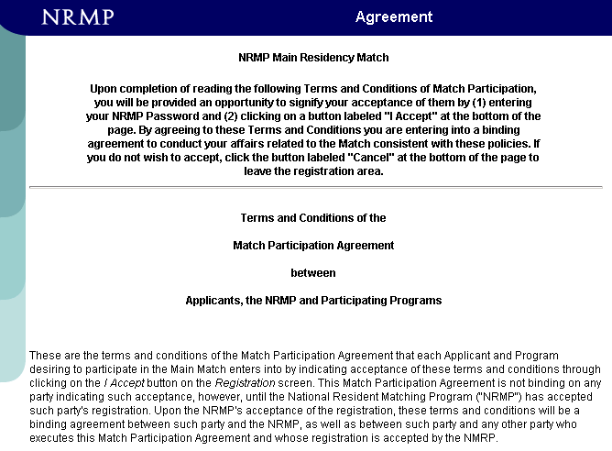
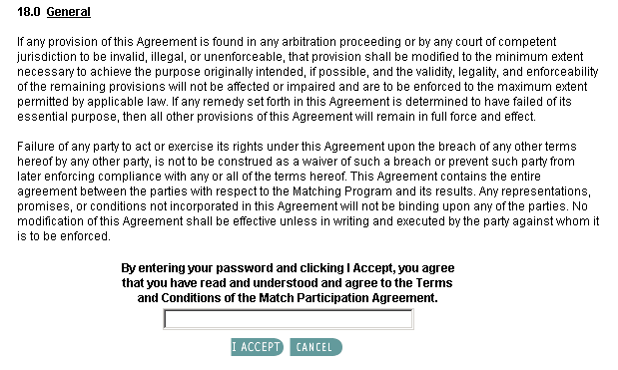
Notes:
As part of their registration, Match participants are required to agree to the terms and conditions of the Match Participation Agreement.
The Match Participation Agreement contains the policies that govern the Main Residency Match, including applicant and program eligibility, and specifies consequences for those who violate those policies.
If a violation is confirmed, the applicant may be subject to penalties as described in the NRMP's Violations Policy.

Slide 29
The Match Commitment
SECTION 5.1:
“The listing of an applicant by a program on its certified rank order list or of a program by an applicant on the applicant's certified rank order list establishes a binding commitment to offer or to accept an appointment if a match results and to begin training in good faith on the date specified in the appointment contract. The same binding commitment is established during the Match Week Supplemental Offer and Acceptance ProgramSM (SOAPSM) if a program offers a position by listing an applicant on its preference list and the applicant accepts that offer.
Failure to honor this commitment by either party participating in a Match will be a breach of this Agreement and may result in penalties to the breaching program or applicant…an applicant who terminates or resigns a position within 45 days of the start date in the appointment contract shall be presumed to have breached this Agreement…”
Notes:
The NRMP recommends applicants consider carefully the programs they include on their rank order list. In certifying a rank order list, the applicant is entering into a contract with the NRMP to accept a position at ANY program should a match occur and to begin training on the date specified in the appointment contract. Failure to accept the position will subject the applicant to a violation investigation and could result in the levying of sanctions.

Slide 30
Match Waivers
In limited circumstances, the NRMP may grant a waiver of the Match commitment.
Applicants:
Hardship
Change of specialty
must be requested by January 15
Completion of residency postponed
Waivers must be requested from, and can be granted only by, the NRMP.
Notes:
The NRMP allows for Match commitments to be waived under special circumstances.
Hardship waivers may be granted to applicants facing unexpected, life-changing circumstances that would impede their ability to perform in a residency training program.
Change of specialty waivers may be granted to applicants who match to advanced (PGY-2) specialty positions and who wish to pursue a different specialty. Waiver requests MUST be submitted by January 15 prior to the start of training in order to be considered. Change of specialty waivers will NOT be granted to applicants who match to preliminary or categorical (PGY-1) positions that commence July 1 after the Match.
Waiver requests MUST be submitted in writing to the NRMP. Applicants and programs are NOT authorized to release each other from a Match commitment.

Slide 31
Match Waivers - Consequences
If a waiver is approved:
The applicant may obtain another position or participate in future Match and the program may begin to recruit for the position.
If a waiver is not approved:
Both the applicant and program are expected to honor the Match commitment.
Failure of either party to honor the Match commitment is grounds for a violation investigation and the levying of sanctions.

Slide 32
Communication between Applicants and Programs
6.0 Restrictions on Persuasion
“One of the purposes of the Main Residency Match is to allow both applicants and programs to make selection decisions on a uniform schedule and without coercion or undue or unwarranted pressure. Both applicants and programs may express their interest in each other; however, they shall not solicit verbal or written statements implying a commitment. Applicants shall at all times be free to keep confidential the names or identities of programs to which they have or may apply.”
Notes:
NRMP policy dictates how applicants and programs may communicate during the Match process.
Applicants and programs are free to express their interest in each other, but parties may NOT request that the other reveal, verbally or in writing, ranking preferences or intentions.

Slide 33
Communication between Applicants and Programs
Section 6.0:
It is a breach of the Match Participation Agreement for:
(a) a program to request applicants to reveal ranking preferences; or
(b) an applicant to suggest or inform a program that placement on a rank order list or acceptance of an offer during SOAP is contingent upon submission of a verbal or written statement indicating the program’s preference; or
(c) a program to suggest or inform an applicant that placement on a rank order list or a SOAP preference list is contingent upon submission of a verbal or written statement indicating the applicant’s preference; or
(d) a program to require applicants to reveal the names or identities of programs to which they have or may apply; or
(e) a program and an applicant in the Main Residency Match to make any verbal or written contract for appointment to a concurrent year residency or fellowship position prior to the release of the List of Unfilled Programs.
Notes:
Applicants can express their interest in a program and vice versa, but it is a Match violation to solicit verbal or written statements from the other party about intentions for ranking.
In addition, programs cannot require applicants to reveal the programs to which they have or may apply.
Report Match violations to the NRMP.
For additional information, please see our “Promoting Success in the Match: What Applicants Should Know and Do” at http://www.nrmp.org/matchtips.pdf.

Slide 34
Examples of Prohibited Communication
In the 2013 Main Residency Match, Dr. Holly Golightly interviewed with the Radiation-Oncology Program at American Hospital Center. She was encouraged at the end of her interview to send the program director a note indicating her level of interest so that the director would know how or whether to rank her.
In the 2013 Main Residency Match, Dr. Harry Potter interviewed with the General Surgery program at Hogwarts Medical Center. Dr. Potter was unsure how to respond when the program director asked where else he planned to interview and if he planned to rank the Hogwarts program as his first choice.

Slide 35
FAMOUS EASTERN MEDICAL SCHOOL GENERAL HOSPITAL
Dear Applicant:
We have thoroughly enjoyed your visit with us and it is clear that you will excel wherever you choose to go.
You represent the kind of candidate that has traditionally done well in our program and we hope to have the opportunity to work with you in the coming year.
Yours sincerely,
Program Director
Notes:
Did the applicant who received this letter match to this program?
No - and this is taken from a real letter.
Be wary of such comments or letters. They are not binding. Do not put too much weight on them when preparing your rank order list.

Slide 36
Violation Investigations
Report potential violation to Executive Director
Information gathered by NRMP
Preliminary Report reviewed by all parties
Case reviewed by Violations Committee
Review Panel Report to violator
Violator can arbitrate
Final Report distributed
Violation policy is at http://www.nrmp.org/res_match/policies/violations.html

Slide 37
Violation by an Applicant
Final Report sent to:
Applicant’s medical school
Directors of residency programs
American Board of Medical Specialties
FSMB* (if applicant is to be permanently barred)
Interested parties
Applicant may be identified as a Match violator in R3 System or barred from future Matches for one to three years, or permanently.
Applicant may be barred from Match-participating programs for one year.
Notes:
FSMB – Federation of State Medical Boards

Slide 38
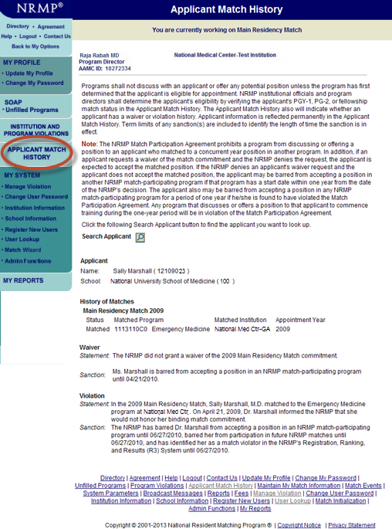
Notes:
The Applicant Match History provides information to program directors and institutional officials about applicant eligibility for appointment. The applicant record identifies his/her Match history and any prior waiver and violation investigation activity. Applicant information is displayed in the Applicant Match History for the duration of the applicant’s sanction.

Slide 39
NRMP Rule for U.S. Seniors
Sponsoring institutions that register any programs in the Main Residency Match agree to select senior students of U.S. allopathic medical schools for all of their programs only through the Main Residency Match or another national matching plan. In addition, programs participating in the Main Residency Match agree to select senior students of U.S. allopathic medical schools only through the Main Residency Match.
Notes:
If any program at a sponsoring institution offers a position outside of the Match to a US senior in an allopathic medical school, the program is in violation of the Match Participation Agreement, regardless of whether the program participates in the Match.

Slide 40
All In Policy
Programs participating in the Main Residency Match must register and attempt to fill all positions through the Main Residency Match or another national matching program.
Notes:
If any program at a sponsoring institution offers a position outside of the Match to a US senior in an allopathic medical school, the program is in violation of the Match Participation Agreement, regardless of whether the program participates in the Match.

Slide 41
Final Considerations
Do not wait until the last minute to enter your rank order list. The servers may be overloaded and very slow.
Do not make last minute changes to your rank order list. Most such changes are not well thought out and applicants frequently regret the changes.
No changes can be made to ROLs after 9:00 p.m. EASTERN time February 20, and only certified lists will be used in the Match.
The NRMP will NOT enter a list, add, delete or move programs or in any way modify a rank order list.
Notes:
Once you have certified your rank order list - forget about it for a few days and relax.

Slide 42
Summary
Prepare a rank order list worksheet with program codes in order of preference before entering them on the “My Rank Order List” screen.
Be sure to certify your rank order list.
Complete your list at least a week before the February 20 deadline.
Relax!

Slide 43


For more information visit:
www.nrmp.org
“Main Residency Match”
Like us on Facebook
www.facebook.com/TheNRMP
Follow us on Twitter
@TheNRMP
Notes:
Check these sources on a regular basis to ensure you stay updated on the latest developments and information

Slide 44
Questions?
202-400-2233 or
1-866-653-6767 (toll-free)
Email: support@nrmp.org
Notes:
Our best wishes for a successful Match!

